Slide 1
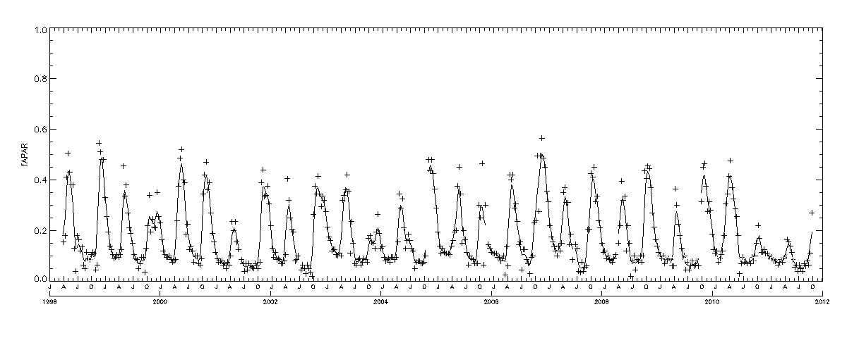
Phenology retrieval
Start from the time series
Fraction of Absorbed Photosynthetically Active Radiation 1 km spatial resolution from SPOT-VGT/PROBA-V
FAPAR
1998 2000 2002 2004 2006 2008 2010 2012
Time

Slide 2
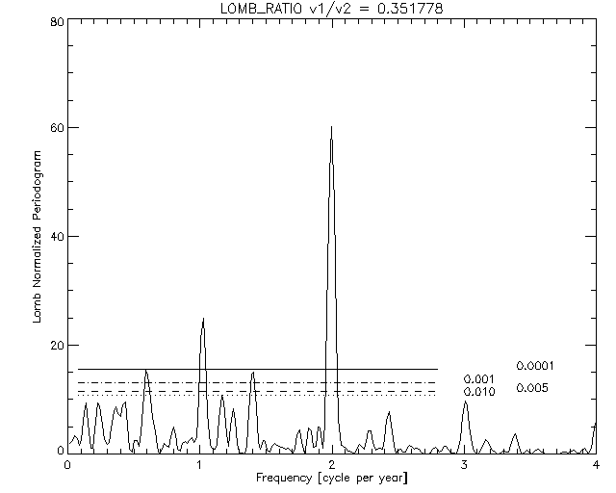
Phenology retrieval
Start from the time series
Determine seasonality using spectral analysis
Power spectrum
1 2
# of cycles per year

Slide 3
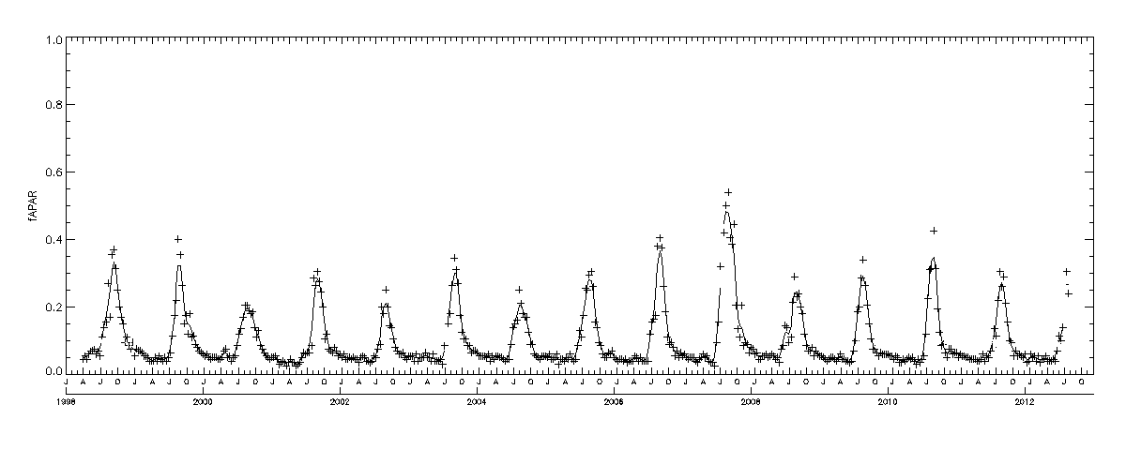
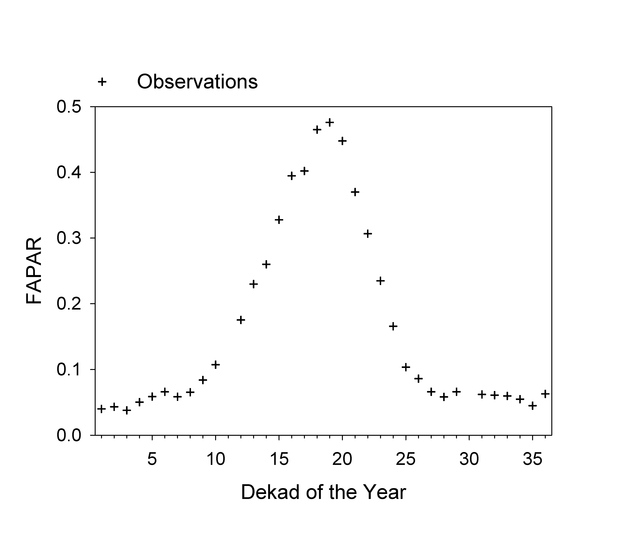
Phenology retrieval
Start from the time series
Determine seasonality using spectral analysis
With the observations of each single season

Slide 4
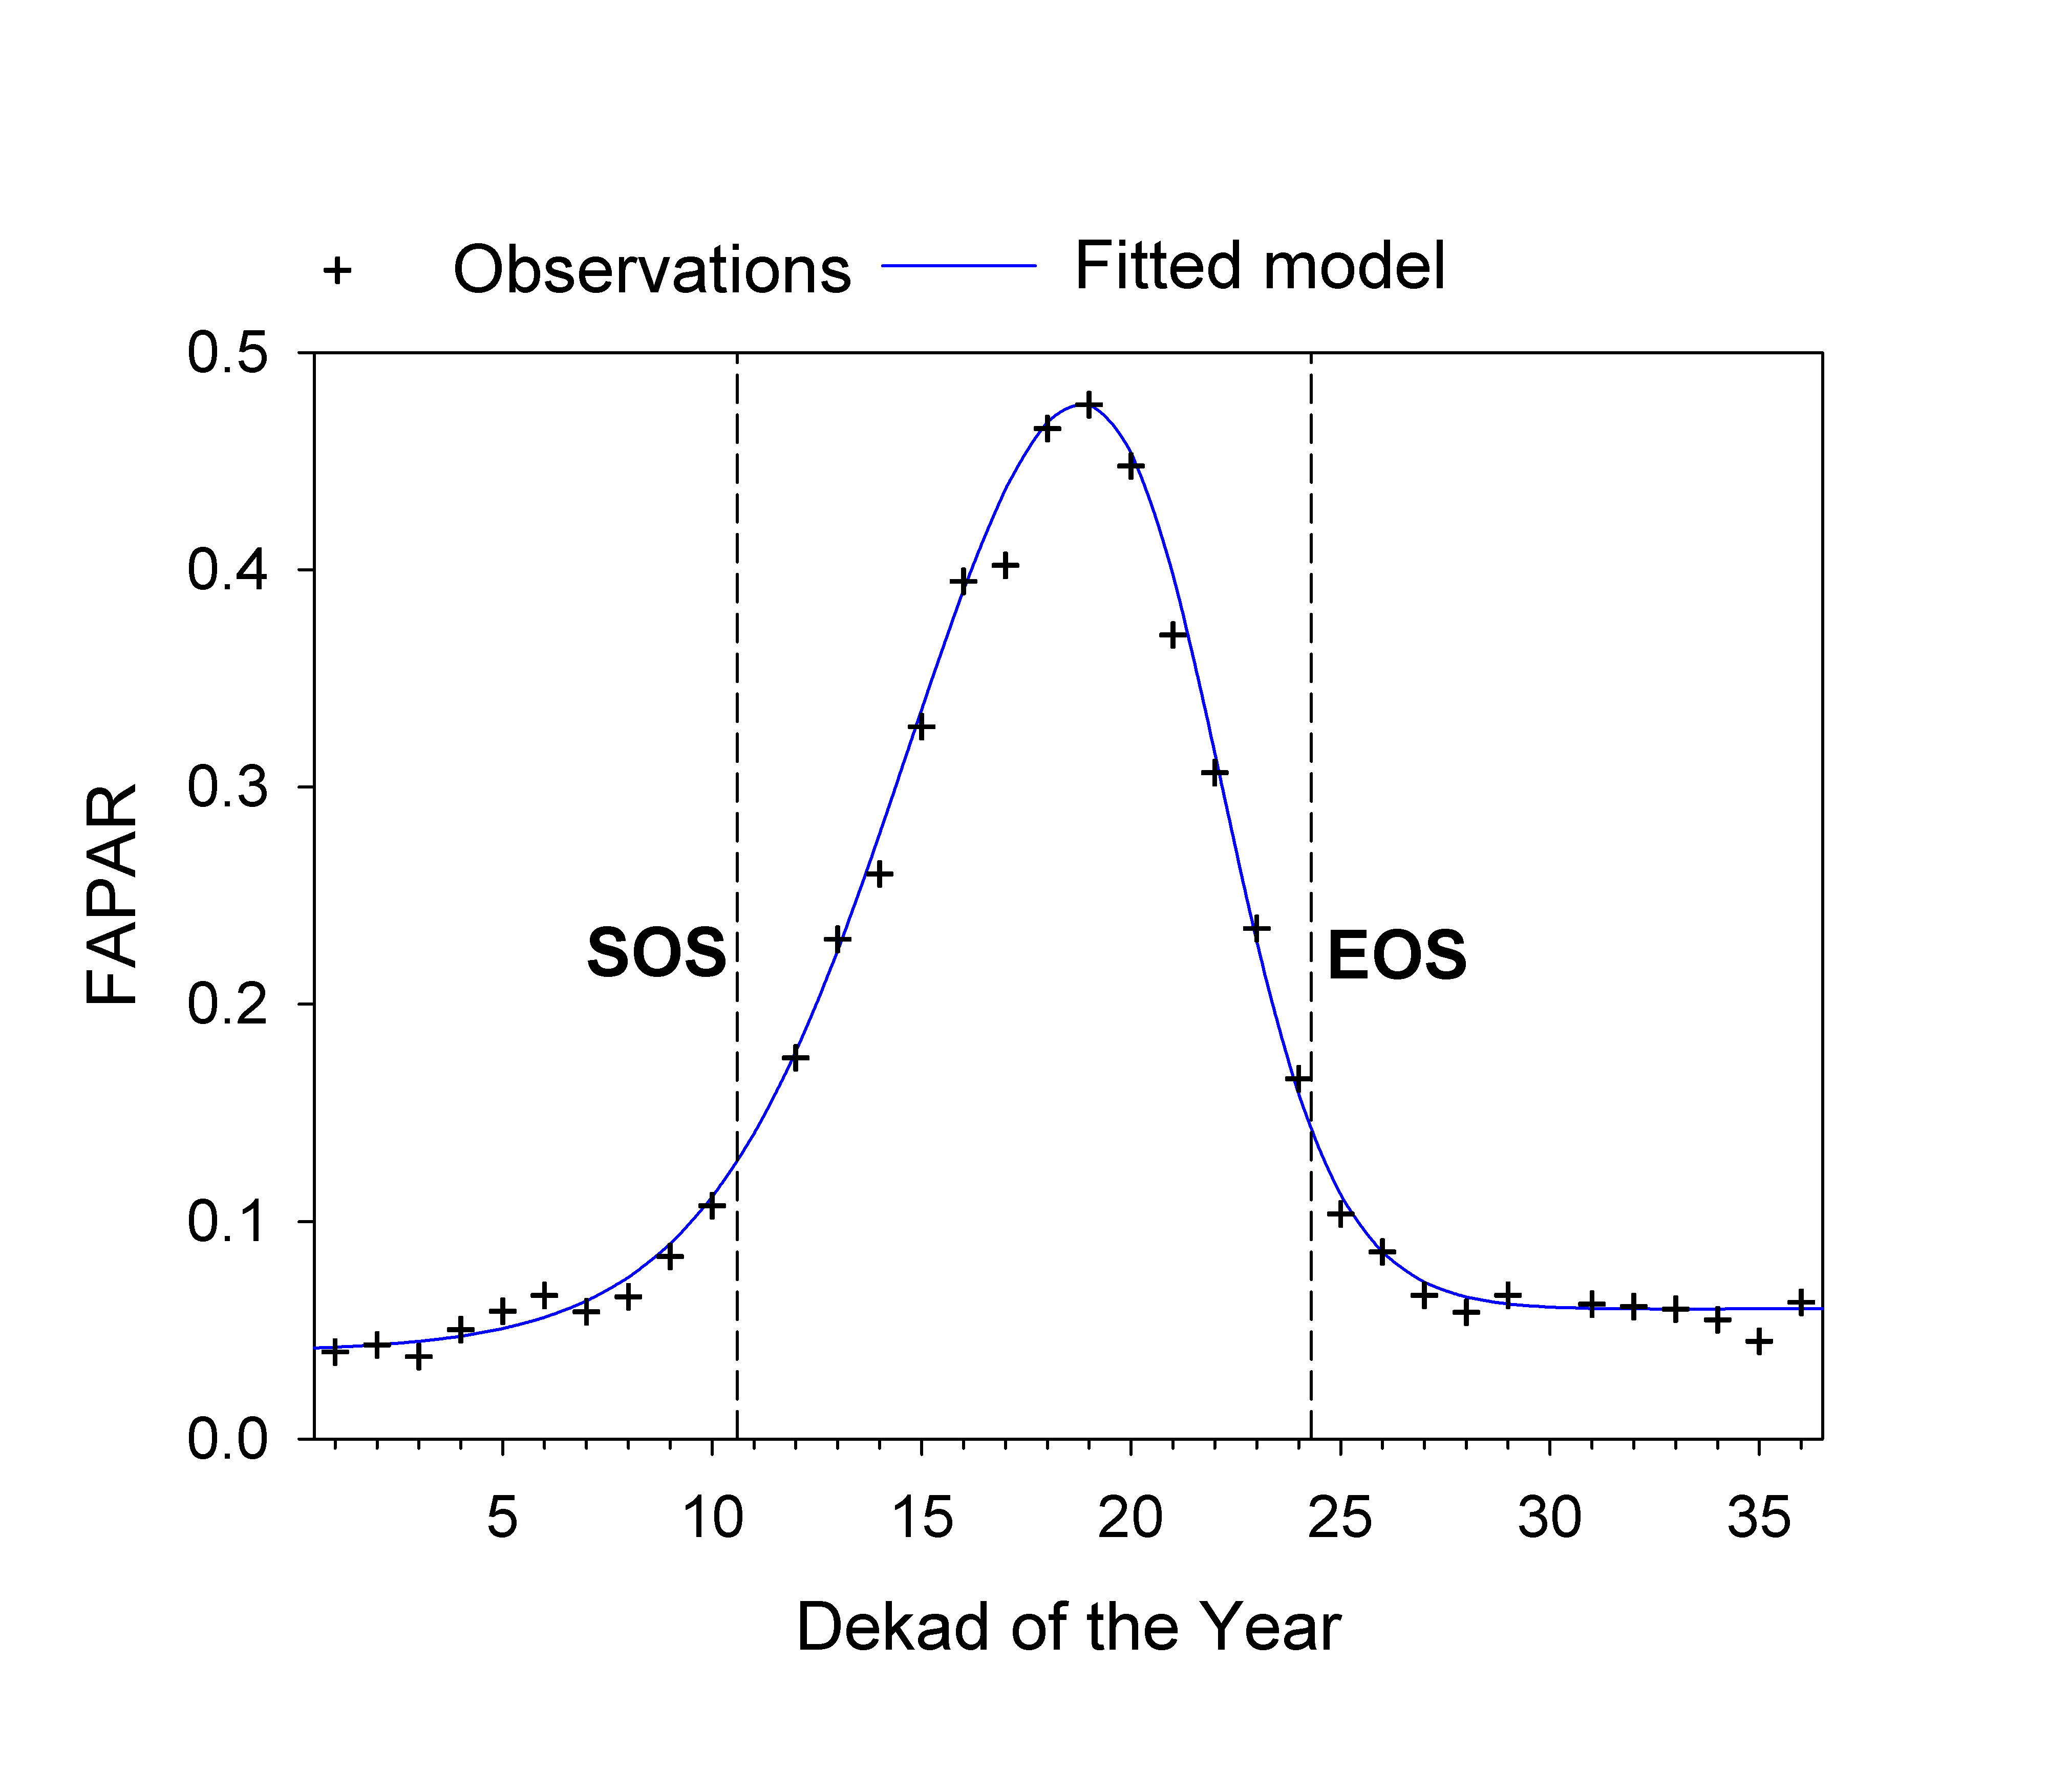
Phenology retrieval
Start from the time series
Determine seasonality using spectral analysis
With the observations of each single season
Fit a DHT model to observations and extract phenology
SOS and EOS based on threshold of growing and decay amplitude

Slide 5
Phenology retrieval
Start from the time series
Determine seasonality using spectral analysis
With the observations of each single season
Fit a DHT model to observations and extract phenology
SOS and EOS based on threshold of growing and decay amplitude
Peak
GSL
Compute the derived phenological parameters
GSL
Peak

Slide 6
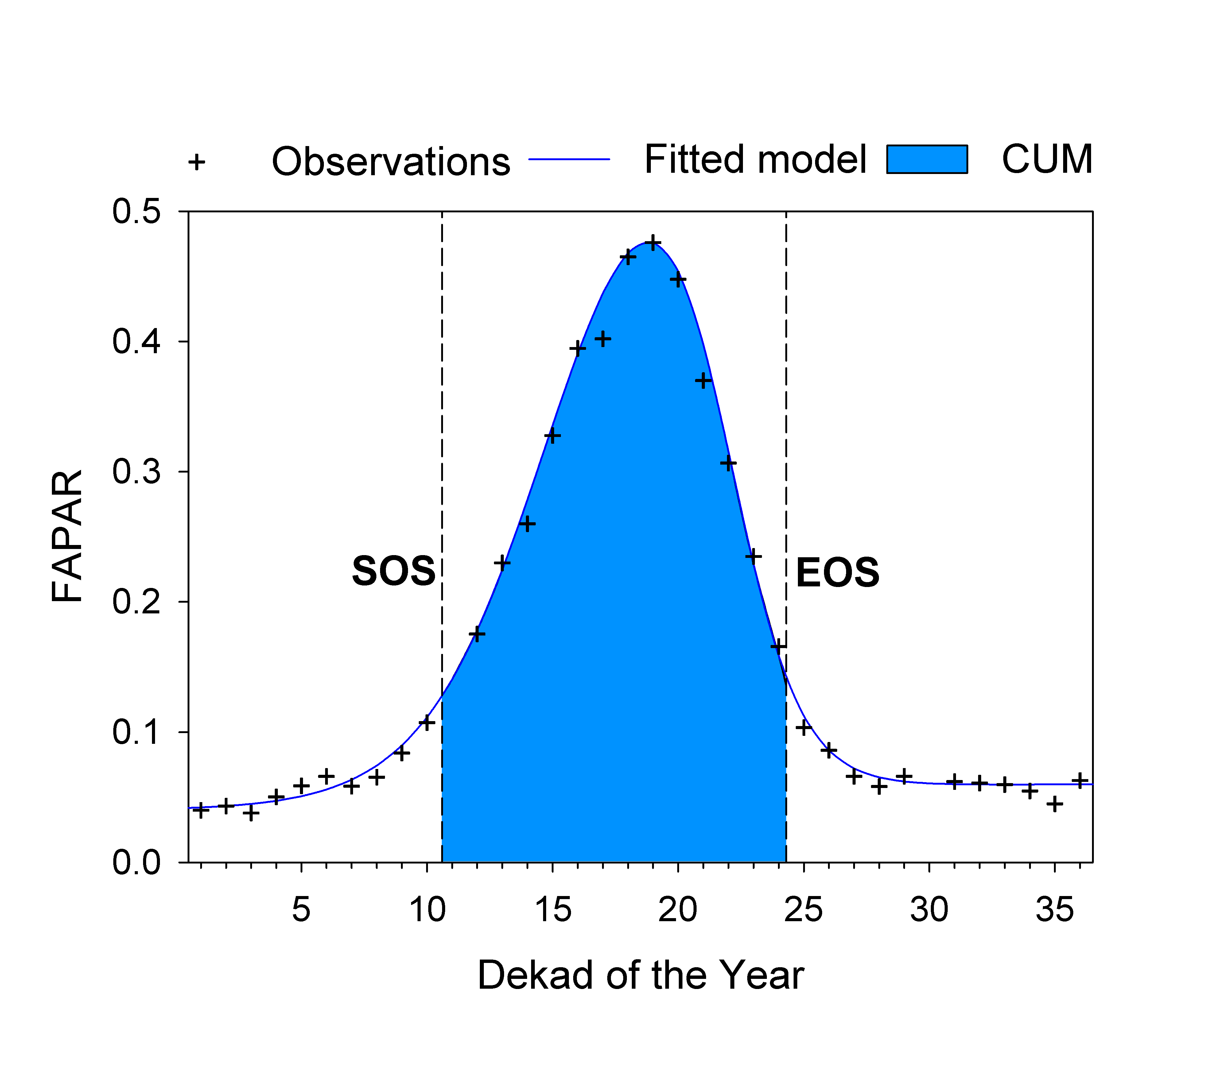
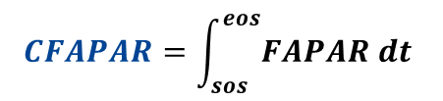
Phenology retrieval
Start from the time series
Determine seasonality using spectral analysis
With the observations of each single season
Fit a DHT model to observations and extract phenology
SOS and EOS based on threshold of growing and decay amplitude
CFAPAR
Compute the derived phenological parameters
GSL
Peak
$$CFAPAR=\int_{sos}^{eos}{FAPAR dt }$$
Seasonal GPP proxy,
Notes:
, and what’s more important

